Slide 1
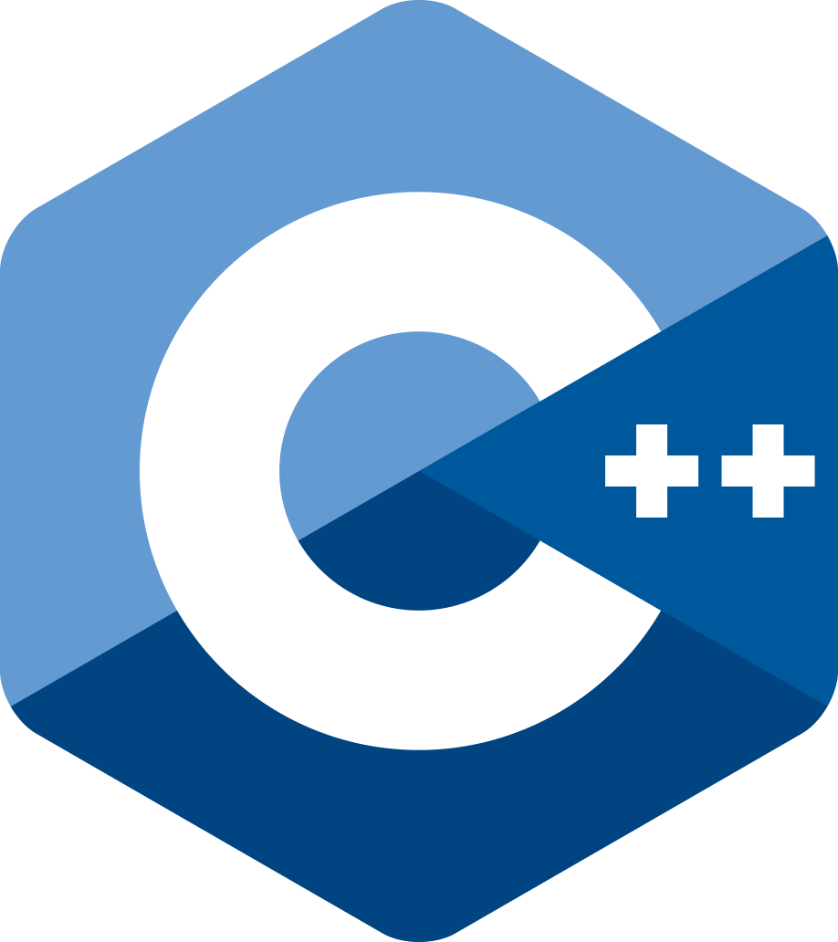


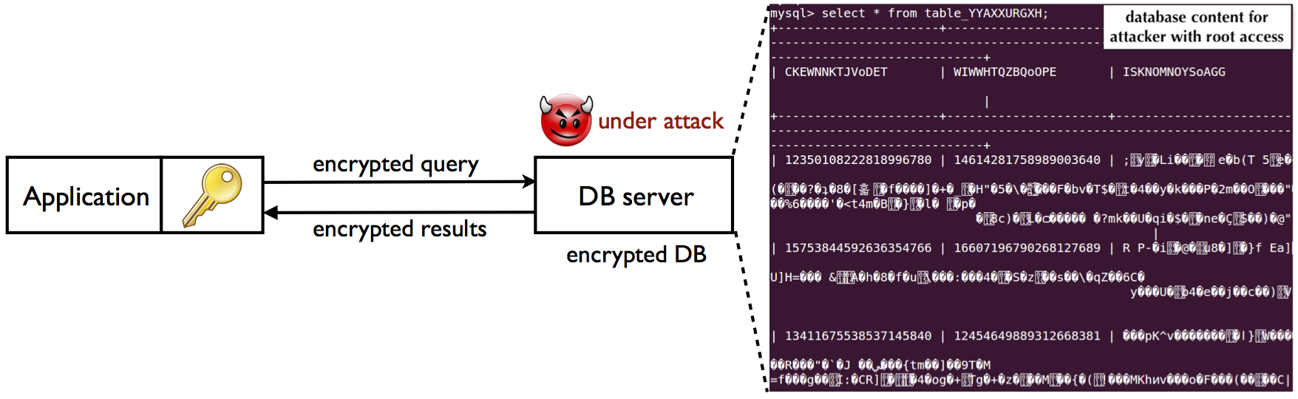
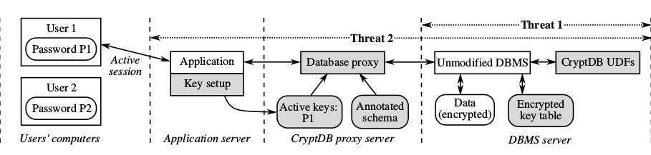
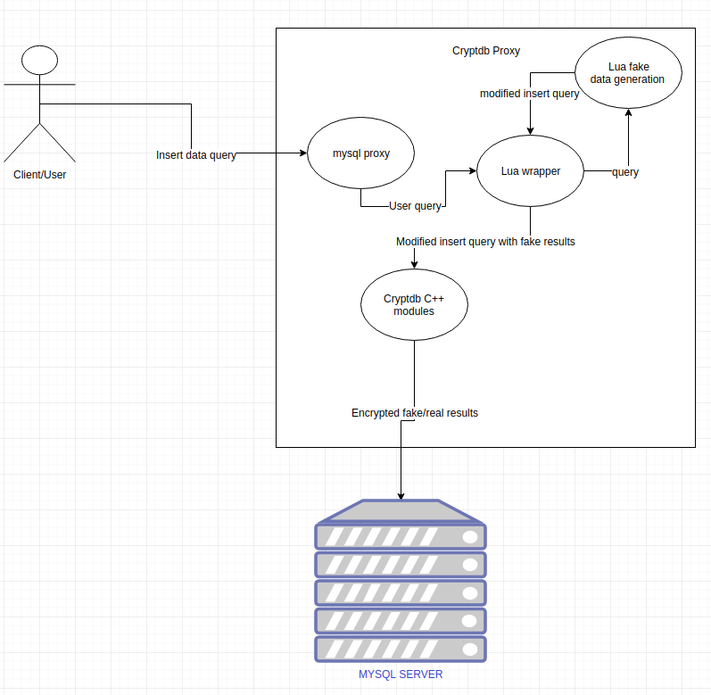
School of Computing & Information Sciences
Senior Project, 2018, Spring
Security Evaluation of Encrypted Databases 1.0
Student: Joannier Pinales, Florida International University
Mentor: Mark Finlayson, Florida International University
Professor: Masoud Sadjadi, Florida International University
Problem
It is becoming increasingly useful to store sensitive information on the cloud. However as many recent hacking attacks have shown, this information is not safe. When institutions that store sensitive information at a large scale are compromised—such as hospitals, financial institutions, or the government—information such as credit card numbers, SSN numbers and medical records of millions of people gets stolen and used for profit.
Solution
A solution to the problem of database breach is to encrypt information before it gets stored. However, any application of purely random encryption completely handicaps functionalities at the DBMS level. Therefore new encryption systems have been developed that still allows query functionality at the DBMS level by taking advantage of different types of encryption and using a proxy to then store the data in encrypted form.
Current System
The current system is a database proxy system developed by MIT from 2008 to 2013 named CryptDB. The proxy system encrypts uses different type of encryption schemes and layers in way that it allow queries to be performed against the information while still encrypted. Some of these encryptions include homomorphic, deterministic, randomized, tokenized text based search and others.
Screenshots
Screenshots are to be relevant to the problem and solution statement.
Requirements
Set up the encrypted database system (Cryptdb) according to security guidelines
Tests different attacks against the system. Specifically frequency analysis attacks against some columns
Implement countermeasure tools against successful attacks. Specifically fake data insertion
System Design
asdasdasd
The system architecture consists of two main parts, the cryptdb proxy server and the DBS (MYSQL). The proxy intercepts all queries and encrypts/adjust queries and data accordingly. The DBS stores the encrypted data. In the case of a data breach into the server, the data is encrypted at the DBS level. Our query/result processing happens at the proxy level before data gets encrypted/decrypted to and from the DBS.
Case Diagram
Implementation
C++ library that consists of a query parser, a query encryptor and rewriter, which encrypts fields or includes UDFs in the query; and a result decryption module.
MySQL proxy with a Lua module that passes queries and results to and the C++ module. Here, insertion queries get intercepted and modified to adjust the frequency of a certain column.
Summary
Cryptdb proxy system protects data to some extent. The use of the system can potentially guard information against a number of threads at the tradeoff of performance overhead. In the specific case of fake data insertion there is an overhead of extra memory and extra processing results at the proxy level. However, our focus was not performance but security and we accomplished the former by preventing frequencies attacks.
Acknowledgement
The material presented in this poster is based upon the work supported by Joannier Pinales, I am thankful to the help that I received from my group members Steven Caceres and Massachusetts Institute of Technology (MIT) graduate students.
Notes:
‹#›

